Slide 1
Use Cases for the Diff Translation

Slide 2
Outline
Basic Definitions
Normal Cases (covered)
Unit has a renderer (trivial)
Unit has no Replace renderer: Replace by Insert and Delete
Diff has no renderer: look up in the tree
Parent-Child (attach)
Exceptional Cases (not covered)
Ordering in Collection
Parent-Child (detach)
Diff dependency
To Investigate
Minimum vs. Batch Diffs

Slide 3
Basic Definitions
JSON
Support basic types: String, Number, Collection, Hash
Does not support (natively): Date, Set
Operations on the JSON data model
Attributes: Create, Destroy, Update
Collection: Insert, Delete, Replace

Slide 4
Basic Definitions
Forward Units
Parents are created before child because they need to attach them once they are created

Slide 5
1.b. Unit has no Replace renderer: Replace by Insert and Delete
If a unit diff has no Replace renderer, Forward simulates it by adding Insert and Delete if they are present

Slide 6
1.c. Diff has no REPLACE renderer: look up in the tree
When no render is specified for a unit, Forward searches for the closest ancestral with a REPLACE renderer
If the root element is reached without a Replace renderer, is simulates it with INSERT and DELETE (case 1.b)
Forward assumes that the root unit provides INSERT and DELETE renderers

Slide 7
1.d. Parent-Child (Attach)
Child components need to be attached to their parents after their respective create operations
There are two ATTACH cases:
Normal cases
Shell cases
The shell case occurs when an SVG element is appended to a DOM element
For some reason, all SVG elements can only be rendered if they are attached to a DOM element
In this case, Forward calls Shell for the child element after the parent is inserted and then inserts and attach the child element
Notes:
TODO: example : pre state, post state diff
Describe that in the model needs the attach
DOM have the property when you create/handle an object you need to attach

Slide 8
Exceptional Cases (not covered)

Slide 9
3.a. Ordering in a Collection
Currently there is no guarantee on the order that tuples within a collection will be rendered
This is needed for ex.:
Polygon drawing in Gmaps
Series in a bar chart in HighCharts
Options in a Dropdown or menu
collection
tuple
tuple
tuple
Which should come first?

Slide 10
3.a. Ordering in a Collection - Example: Insert DropDown
Pre-state:
{ __id__ : "",
onchange: true,
selected: 2,
options: [
{__id__: 1, value: 1, label: "a"},
{__id__: 2, value: 2, label: "b"},
{__id__: 3, value: 3, label: "c"}
],
disabled: false,
multiple: false
}
Diff
{
__context__: “options/",
__pos__: 3,
__op__: ”insert",
__payload__:
{__id__: 4, value: 4, label: "d"}
}
Post-state:
{ __id__ : "",
onchange: true,
selected: 2,
options: [
{__id__: 1, value: 1, label: "a"},
{__id__: 2, value: 2, label: "b"},
{__id__: 4, value: 4, label: "d"},
{__id__: 3, value: 3, label: "c"},
],
disabled: false,
multiple: false
}

Slide 11
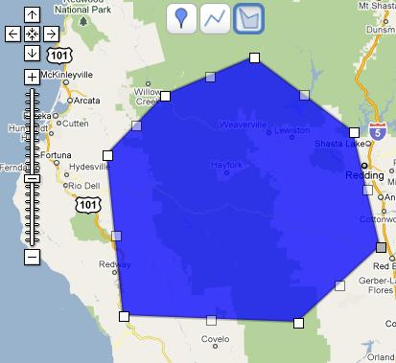
3.a. Ordering in a Collection – Example: Insert Maps Polygon
Diffs:
{
__context__: "/markers/[pos=1]",
__op__: ”insert",
__payload__:
{__id__: 1, lat: 25.774252, lng: -80.190262}
}
{
__context__: "/markers/[pos=2]",
__op__: ”insert",
__payload__:
{__id__: 2, lat: 22.774252, lng: -83.190262}
}
{
__context__: "/markers/[pos=3]",
__op__: ”insert",
__payload__:
{__id__: 3, lat: 25.774252, lng: -88.190262}
}
Notes:
Are more diffs needed? (e.g. move id:3)
var triangleCoords = [ new google.maps.LatLng(25.774252, -80.190262), new google.maps.LatLng(18.466465, -66.118292), new google.maps.LatLng(32.321384, -64.75737), new google.maps.LatLng(25.774252, -80.190262) ];

Slide 12
3.b. Parent-Child (Detach)
Simulation may lead to replacement of a unit
If the unit has
It needs to follow this sequence:
DETACH from the parent, DELETE, INSERT, ATTACH to the parent
Currently there is not DETACH operator

Slide 13
2. Parent-Child Issues (1/2)
The INSERT renderer of a child unit instance can be invoked while its component has not been attached to the DOM
In this case:
INSERT fragment on parent's root attribute
INSERT fragment on child's root attribute
ATTACH fragment on parent's placeholder attribute for the child
E.g.
collection
tuple

Slide 14
2. Parent-Child Issues (2/2)
The INSERT renderer of a child unit instance can only be invoked after its component has been attached to the DOM
In this case:
INSERT fragment on parent's root attribute
SHELL fragment on child's root attribute
ATTACH fragment on parent's placeholder attribute for the child
INSERT fragment on child's root attribute
E.g.
I
II
III
IV
DIV
DIV
DIV
DIV
DIV
SVG
[ ]
[ ]
SVG
Circle
Text
Circle
Text
Notes:
DETACH: when simulate replace in the child, delete must detach
Replacement: - no component supp attach/detach you only need the parent

Slide 15
3. Diff Dependency
There may be dependencies between diffs
Examples:
drawing order of edges and nodes (nodes should be drawn first)
TreeMap: size of a node depends on the size of the other nodes
Edge Diff
{
__context__: "/graph/edges",
__op__: ”insert",
__payload__:
{__id__: 1, source_id: 3, target_id: 4}
}
Node Diffs:
{
__context__: "/graph/nodes",
__op__: ”insert",
__payload__:
{__id__: 3, label: ”USA”}
}
{
__context__: "/graph/nodes",
__op__: ”insert",
__payload__:
{__id__: 4, label: ”Canada”}
}
Notes:
Are more diffs needed? (e.g. move id:3)

Slide 16
3. Diff Dependency
A simple solution: Explicitly declare dependencies
Problem: circular dependencies (e.g. 1 → 2, 2 → 3, 3→1)
Solution: Define priority queue
Example Graph - Diffs:
{
__id__: 1,
__priority__: { 1 },
__context__: "/graph/edges",
__op__: ”insert",
__payload__:
{__id__: 1, source_id: 3, target_id: 4}
}
{
__id__: 2,
__priority__: { 2 },
__context__: "/graph/nodes",
__op__: ”insert",
__payload__:
{__id__: 3, label: ”USA”}
}
{
__id__: 3,
__priority__: { 2 },
__context__: "/graph/nodes",
__op__: ”insert",
__payload__:
{__id__: 4, label: ”Canada”}
}
Notes:
{
__id__: 1,
__dependency__: { after: [2, 3] },
__context__: "/graph/edges",
__op__: ”insert",
__payload__:
{__id__: 1, source_id: 3, target_id: 4}
}

Slide 17
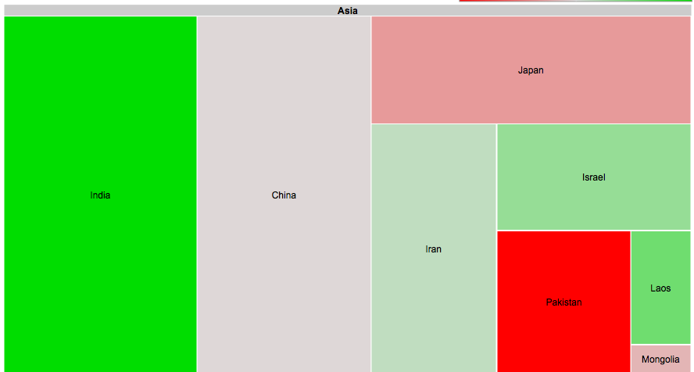
3. Diff Dependency
Managing dependencies can be a tough task for the unit developer
A naïve solution is to specify renders only for the root element (resulting in a total redraw)
But total redraw may assign different position/colors to the element!
Notes:
Better examples

Slide 18
To Investigate

Slide 19
4. Special Cases – Minimum vs. Batch diffs (1/3)
Example Diff – Update Marker position (GMaps)
{
"__context__": "/markers/[_id=2]",
"__op__": "update",
"__payload__":
{ "lat" : 32.83428, "lng": -117.24764 }
}
As opposed to two diffs:
{
"__context__": "/markers/[_id=2]",
"__op__": "update",
"__payload__":
{ "lat" : 32.83428 }
}
{
"__context__": "/markers/[_id=2]",
"__op__": "update",
"__payload__":
{"lng": -117.24764 }
}
Notes:
TODO: provide a method “I’m done” called once per unit instance. Accumulate diffs. Layout command.

Slide 20
4. Special Cases – Minimum vs. Batch diffs (2/3)
Batch diffs can provide simpler and more efficient updates
Example
function updateComponentCallback(new_val, old_val, id){
if (new_val && old_val) { // update
var marker = id.getObject();
var newPosition = new google.maps.LatLng(new_value.lat,new_value.lng)
marker.setPosition(newPosition);
}
}
In case of Minimum diffs, the function would be called for each diff, which may not be efficient
The developer should take care of each diff individually (e.g. check if it is lat or lng update)

Slide 21
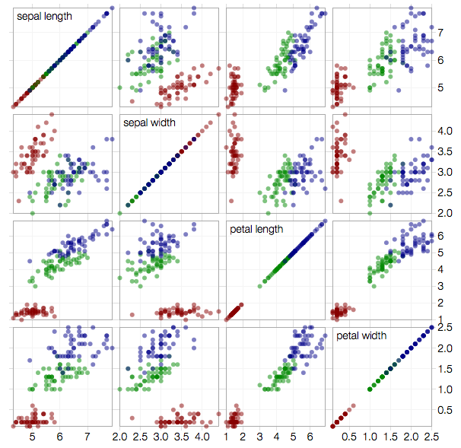
4. Special Cases – Minimum vs. Batch diffs (2/3)
Consider incremental updates on a Scatterplot Matrix with hundreds of data points
Every page diff would trigger a high number of calls to the drawing method
Batch updates in this case would have a positive impact of performance

Slide 22
4. Special Cases – Minimum vs. Batch diffs (3/3)
Callback Problem:
If lat’ is modified, which callback function should be called passing which arguments?
Marker
UpdateMarkerCallback(Marker)
UpdateLatitude(C’)
lat’
lng
Notes:
Investigate. How to handle? What are the corner cases?

Slide 23
A
B
UpdateMarkersCallback(B)
siblings
C’
Callback2(C’)
child
siblings

Slide 24
Diff Translation Algorithm

Slide 25
Diff Translation Algorithm
Input
A page data diff, comprising of a context and a payload
Output
List of supported unit diffs, which are operations that direct the incremental rendering of the page
Assumptions
The input page data tree is ordered
Guarantees
Root of unit diff has a renderer
The most specific renderers for the page diff are chosen
Non-overlapping diffs
Tree ordering (post-order)
Notes:
Procedure
Split the page data diff in diffs specific to a renderer
Look for the corresponding renderer operation in the diffs
If not present, simulate it
Return the supported and simulated unit diffs
New Unit diffs may be generated
Order in the list reflects how they are going to be applied
Diffs will be applied in the order in which they were declared
Guarantees ordering
There is no dependency between siblings besides “order”

Slide 26
Requirements for Edge Cases
R1. Ordering in collection
The algorithm should preserve the ordering
Default: Order in which the tuples were declared
R2. Detaching a child from the parent when deleting
DELETE render should DETACH before removing a child from the parent
R3. Diff priority
Take into account explicitly declared priority number
R4. The LAYOUT operator
Called only once per visual unit
Notes:
Replace:
Siblings of a node without R/I/D renderers cannot generate fragments (it will be assigned to the closest ancestral with a renderer)
4. E.g. Simulating REPLACE render may create INSERT diffs out of order

Slide 27
Simulation
Simulation cases
If there is not RENDERER for a root element, try CREATE and DESTROY
If there is no CREATE or DESTROY for the root element, find the closest ancestor with REPLACE
If REPLACE or DESTROY occurs in the root of a unit instance tree, needs to DETACH and ATTACH from its parent

Slide 28
The new DiffTranslator algorithm
Three-pass algorithm:
Visit down the tree and find the appropriate render for each node
Find or simulate unit diffs for the root of unit configs
Generate attach/detach where necessary
Store unit diffs in each node of the unit instance tree
Visit tree, collect the unit diffs and check the LAYOUT condition
Add LAYOUT operator after all diffs of a particular unit
Remove the nodes marked for deletion from the unit instance tree
Each step takes O(N) in computation time
Pros:
Identify roots of unit configs more efficient than previous solution
Node visiting follows the tree structure
The simulation process occurs at the same time as the fragmentation
Cons:
Multiple passes through the tree
Notes:
Pros: The simulation process knows a priori which simulation needs to be done at each node and optimizations can be done
Cons: Multiple passes through the tree, flag needed
Resolve ordering, dependencies
Sort attributes/tuples in a collection according to abs. position (?)

Slide 29
DiffTranslator - Step 1: Find/simulate renders for each node
def translate(page_data_diff):
get the closest unit_config
get or create a unit_instance for the root
if unit_instance is root of unit_config:
attach it to the unit_instance_tree
// Check for simulation in the root
if page_data_diff is CREATE:
if unit_instance has no CREATE renderer:
simulate_create(unit_instance, page_data_diff)
else:
add CREATE, ATTACH renderer to the unit_instance
else if page_data_diff is REPLACE:
if unit_instance has no REPLACE renderer:
simulate_replace(unit_instance, page_data_diff)
else:
add DELETE, REPLACE, INSERT renderer to the unit_instance
else if page_data_diff is DESTROY:
if unit_instance has no DESTROYrenderer:
simulate_destroy(unit_instance, page_data_diff)
else:
add DETACH, DESTROY renderer to the unit_instance
else:
attach it to the parent_unit_instance
Notes:
TODO: INSERT and DELETE for collections?
translate_replace(unit_config, unit_instance, page_data_diff)

Slide 30
DiffTranslator - Step 1: Find/simulate renders for each node
def translate(page_data_diff):
(…) cont.
// visit children in the Unit Config tree generating create and destroy
if page_data_diff is CREATE:
generate_create_children(unit_config, page_data_diff)
else if page_data_diff is REPLACE:
generate_create_children(unit_config, page_data_diff)
generate_destroy_children(unit_config, page_data_diff)
else if page_data_diff is DESTROY:
generate_destroy_children(unit_config, page_data_diff)
Notes:
TODO: INSERT and DELETE for collections?
translate_replace(unit_config, unit_instance, page_data_diff)

Slide 31
DiffTranslator - Step 1: Find/simulate renders for each node
def simulate_create(unit_instance, page_data_diff):
unit_diff = simulate_closest_replace(unit_instance, page_data_diff)
extended_diffs = resolve_attach(unit_diff) // insert attach
add extended_diffs to the unit_instance
def simulate_replace(unit_instance, page_data_diff):
if unit_instance has no CREATE or DESTROY renderer:
unit_diffs = simulate_insert_delete(unit_instance, page_data_diff)
else:
unit_diffs = simulate_closest_replace(unit_instance, page_data_diff)
extended_diffs = resolve_detach_attach(unit_diffs) // insert detach-attach
add extended_diffs to the unit_instance
def simulate_destroy(unit_instance, page_data_diff):
extended_diffs = resolve_detach(unit_diff) // insert detach
add extended_diffs to the unit_instance
Notes:
TODO: INSERT and DELETE for collections?
translate_replace(unit_config, unit_instance, page_data_diff)

Slide 32
DiffTranslator - Step 1: Find/simulate renders for each node
def generate_create_children(unit_config, unit_instance, page_data_diff):
for child in unit_config.children():
for child_payloads in page_data_diff.get_child_payload():
get child_page_data_diff
unit_diff = new UnitDiff(child_payload, CREATE)
add unit_diff to the unit_instance
translate(child_page_data_diff)
return
Notes:
QUESTION: is ATTACH needed for children of the same unit config?

Slide 33
DiffTranslator – Step 2: Collect unit diffs and check for LAYOUT
def resolve(unit_instance_tree=root):
for child in unit_instance_tree.children():
resolve(child)
return
Notes:
Fix X = in a replace page diff will call Insert and Delete of the children regardless whether the children have a REPLACE RENDERER

